Slide 1
SSH Overview

Slide 2
1.
What is SSH?
Let’s start with a brief refresher!

Slide 3
Secure Shell
Network protocol for securely communicating between computers

Slide 4
SSH Connection
“using SSH”
reference to using an SSH client to connect to another computer's SSH server
remotely run commands on that computer
Any computer is capable of running both an SSH client and a server.

Slide 5
2.
SSH Settings
Now let’s get into the nitty gritty :)

Slide 6
Disabling Root Login
How?
/etc/ssh/sshd_config
Default value: without-password or yes
Modify:
PermitRootLogin no
Why?
Prevents users logging into an SSH server to log in as the root account & gain complete control of the server machine

Slide 7
Disabling Empty Passwords
Why?
Passwords are ESSENTIAL!
How?
/etc/ssh/sshd_config
Default value: without-password or yes
Modify:
PermitEmptyPassword no

Slide 8
Disabling Password Authentication
How?
/etc/ssh/sshd_config
Default value: yes but commented out
Modify:
PasswordAuthentication no
Why?
Allows clear text passwords to be accepted by SSH
EXTREMELY insecure to have unencrypted password

Slide 9
Ensure Correct SSH Protocol
How?
/etc/ssh/sshd_config
Default value: 2
Modify:
Protocol 2
Why?
Older version, 1, is less secure and can pose many compatibility issues
Feel free to look up the differences
http://www.snailbook.com/faq/ssh-1-vs-2.auto.html

Slide 10
Allow/Deny
Users
Why?
To restrict or grant access to certain users
By default all users are allowed
How?
/etc/ssh/sshd_config
Default value: none
Add:
AllowUsers user1 user2
DenyUsers user1 user2

Slide 11
Changing Port #
How?
/etc/ssh/sshd_config
Default value: 22
Modify:
Port [#]
Why?
Setting SSH to listen on another port number will make it harder for hackers to attempt to breach your server

Slide 12
User Environment Processing
How?
/etc/ssh/sshd_config
Default value: none
Add:
PermitUserEnvironment no
Why?
May enable users to bypass access restrictions
Can edit environmental variables to point to unwanted files or command

Slide 13
Public Key Authentication
How?
/etc/ssh/sshd_config
Default value: yes
Modify:
PubkeyAuthentication yes
Why?
To generate a key pair (a private key and a public key) in order to make SSH login more secure
Recommended over password authentication.
Notes:
https://medium.com/@Imesha94/enabling-public-key-ssh-authentication-on-your-vps-fe5bfbf94822

Slide 14
Limiting Auth Attempts
Why?
Limits the number of auth failures per connection
How?
/etc/ssh/sshd_config
Default value: none
Add:
MaxAuthTries 4

Slide 15
Host Based Authentication
How?
/etc/ssh/sshd_config
Default value: no
Modify:
HostbasedAuthentication no
Why?
Specifies if authentication is allowed through trusted hosts via the user of .rhosts, or /etc/hosts.equiv
Notes:
Will talk about why these should not exist on the system

Slide 16
.rhost file
Specifies which users can access specific commands
Located in specific user’s home directory
Prime target for malicious attacks
YOU DON’T WANT THIS FILE ON YOUR SYSTEM!!

Slide 17
IgnoreRhosts
How?
/etc/ssh/sshd_config
Default value: yes
Modify:
IgnoreRhosts yes
Why?
.rhosts files are BAD
We just learned why :)
Notes:
Will talk about why these should not exist on the system

Slide 18
/etc/hosts.equiv file
Specifies which accounts are allowed access
Hackers can spoof IP addresses & hostnames to gain access
THIS IS ALSO A BAD FILE!!
Notes:
Bypassing of proper authentication steps

Slide 19
SSH Keys
Key to unlocking the secrets :)

Slide 20
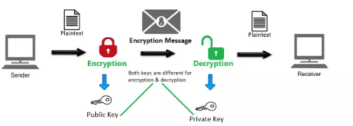
SSH Keys
Public key and private key
Key-based authentication system
Notes:
Alternative to password authentication
Because the key pair is mathematically related, whatever is encrypted with a Public Key may only be decrypted by its corresponding Private Key and vice versa.

Slide 21
Public vs Private Keys
Public key
Made available to anyone
Private Key
Retained by the client & should be kept in absolute secrecy
Can be encrypted on disk w/ a passphrase

Slide 22
Important Files
~/.ssh/authorized_keys
Configures permanent access using SSH keys
~/.ssh/id_rsa and ~/.ssh/id_rsa.pub
Will get into these in the next slide
Notes:
~/.ssh/authorized_keys → specifies the SSH keys that can be used for logging into the user account for which the file is configured

Slide 23
Creating SSH Keys
ssh-keygen
Generates an SSH key pair
Private key will be stored in ~/.ssh/id_rsa
Public key will be stored in ~/.ssh/id_rsa.pub
Notes:
By default the keys will be stored in ~/.ssh directory

Slide 24
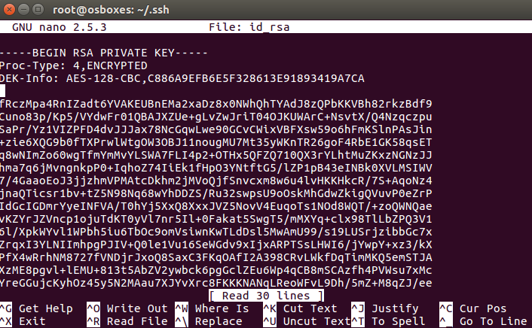
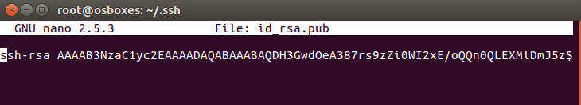
SSH Key Files

Slide 25
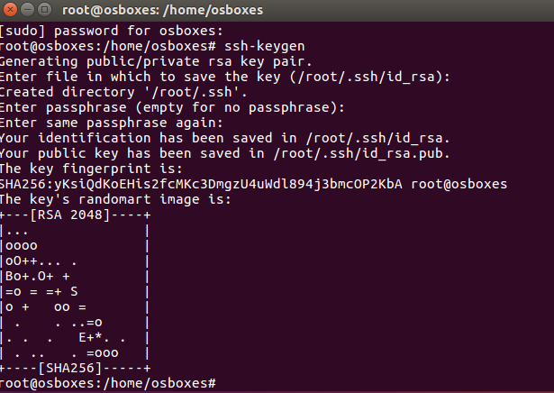
ssh-keygen

Slide 26
File Permissions
.ssh directory → 700 (drwx------)
~/.ssh/id_rsa.pub → 644 (-rw-r--r--)
~/.ssh/id_rsa → 600 (-rw-------)
~/.ssh/id_rsa should NEVER be accessible to anyone other than you (and the root user)
~/.ssh/authorized_keys → 600 (-rw-------)

Slide 27
THANKS!
Any questions?

